Slide 1
Conference
“The integration of young people excluded by early school leaving
and unemployment: challenges and solutions”
-
Brussels - Friday 8 May 2015 - hosted by the Foundation P&V
Effective strategies and
good practice for the
Assuring of Success in School
Workshop II - Intervention
Sylvia Ruge
Programm Manager &
Director of DKJS regional office SA

Slide 2
Outline
Program structure, aims and results
Actors’ activities in the schools, in the districts and on the federal state level
Effective strategies to develop a culture of cooperation
Summary and outlook
Sylvia Ruge
Programm Manager &
Director of DKJS regional office ST

Slide 3
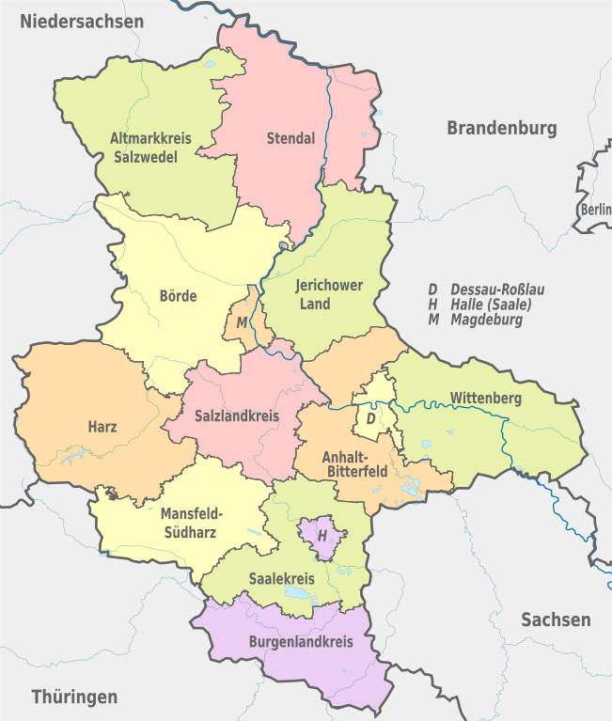
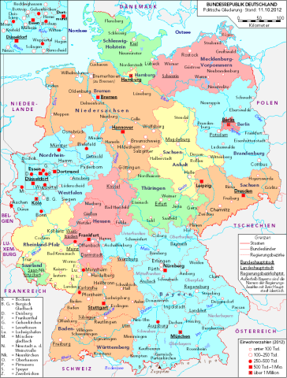
Saxony-Anhalt
Source: Wikimedia Commons / Author: C. Busch, Hamburg / Licence: CC BY-SA 3.0
http://commons.wikimedia.org/wiki/File:Deutschland_politisch_2010.png
Source: Wikimedia Commons / Author: TUBS / Licence: CC BY-SA 3.0
http://de.wikipedia.org/wiki/Datei:Saxony-Anhalt,_administrative_divisions_-_de_-_colored.svg
Germany
One of the highest school drop-out
rates in Germany (2004/2005)
→ 12 %
Sylvia Ruge
Programm Manager &
Director of DKJS regional office ST

Slide 4
Aim of the program (2009 – 2014)
-
„Schulerfolg sichern – Maßnahmen gegen Schulversagen
und gegen Schulverweigerung in Sachsen-Anhalt“
("Succeeding in school – Measures against school failure and truancy in Saxony-Anhalt")
Lowering of the 12% drop-out rate to 8,6%
&
Lowering of grade repetitions by about 50 %
by 2013
In order to achieve our shared aim …
→ Implementation of a complex program structure
Sylvia Ruge
Programm Manager &
Director of DKJS regional office SA

Slide 5
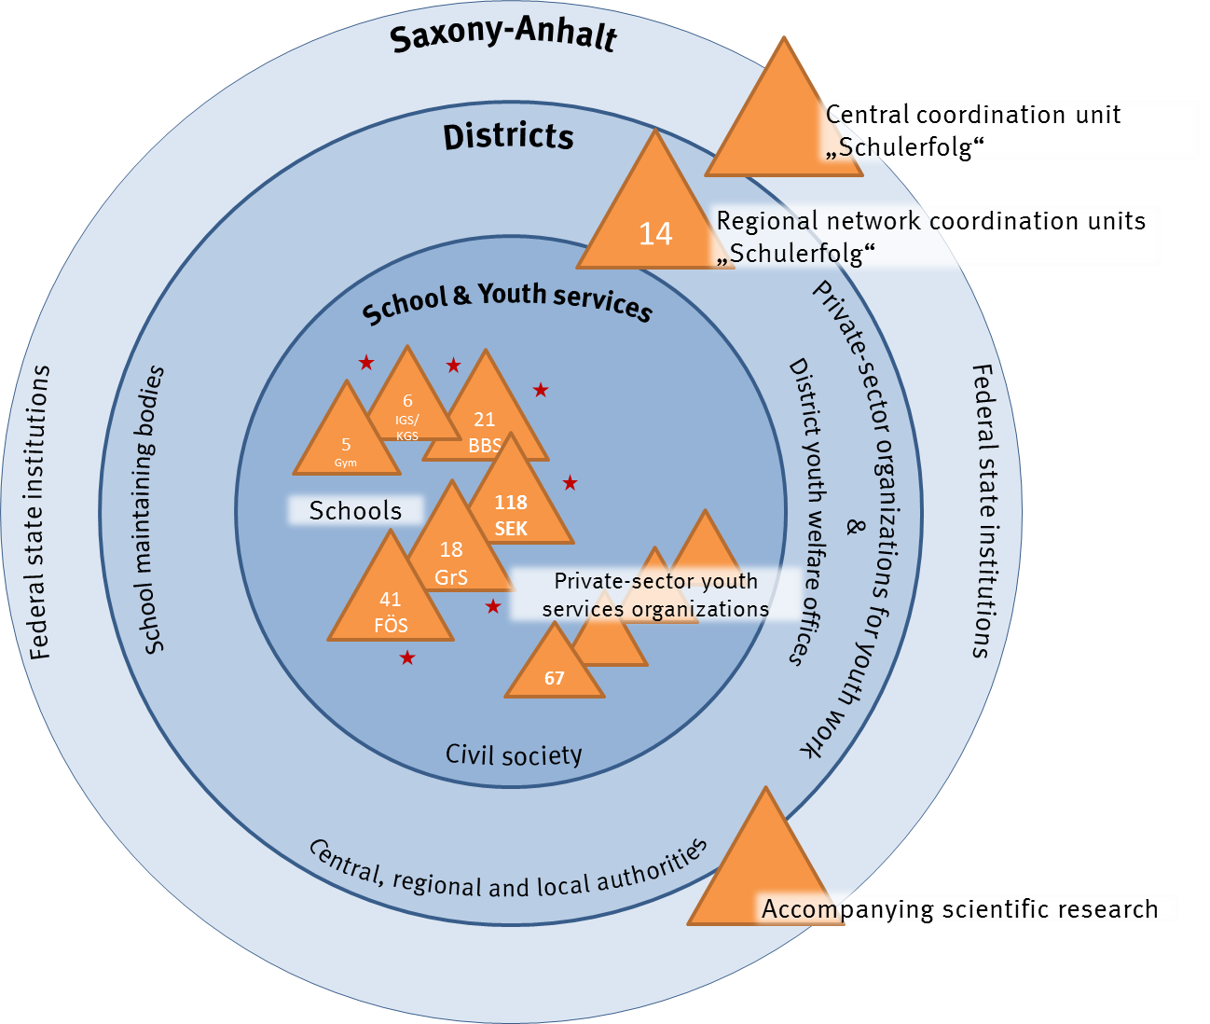
Structure
Sylvia Ruge
Programm Manager &
Director of DKJS regional office SA

Slide 6
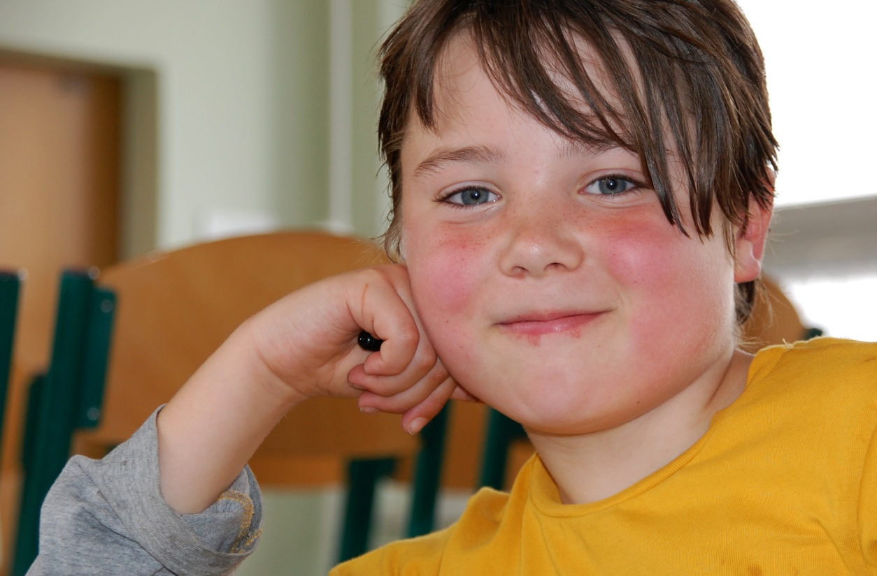
Results
Every year more than 30.000 pupils,
over 8.000 parents and guardians
and over 4.700 educators come in contact with the program.
&
The drop out rate fell during the 2013/2014 school year to about 9,8% (aim 8,6 %). Still too many, this is about 1500 schoolchildren in Saxony-Anhalt.
Sylvia Ruge
Programm Manager &
Director of DKJS regional office SA

Slide 7

Findings
Children and youths …
…become motivated and set their own goals
…become confident in their ability to learn
…feel safe and accepted
Youth
services
Local
authorities
School
Sylvia Ruge
Programm Manager &
Director of DKJS regional office SA

Slide 8
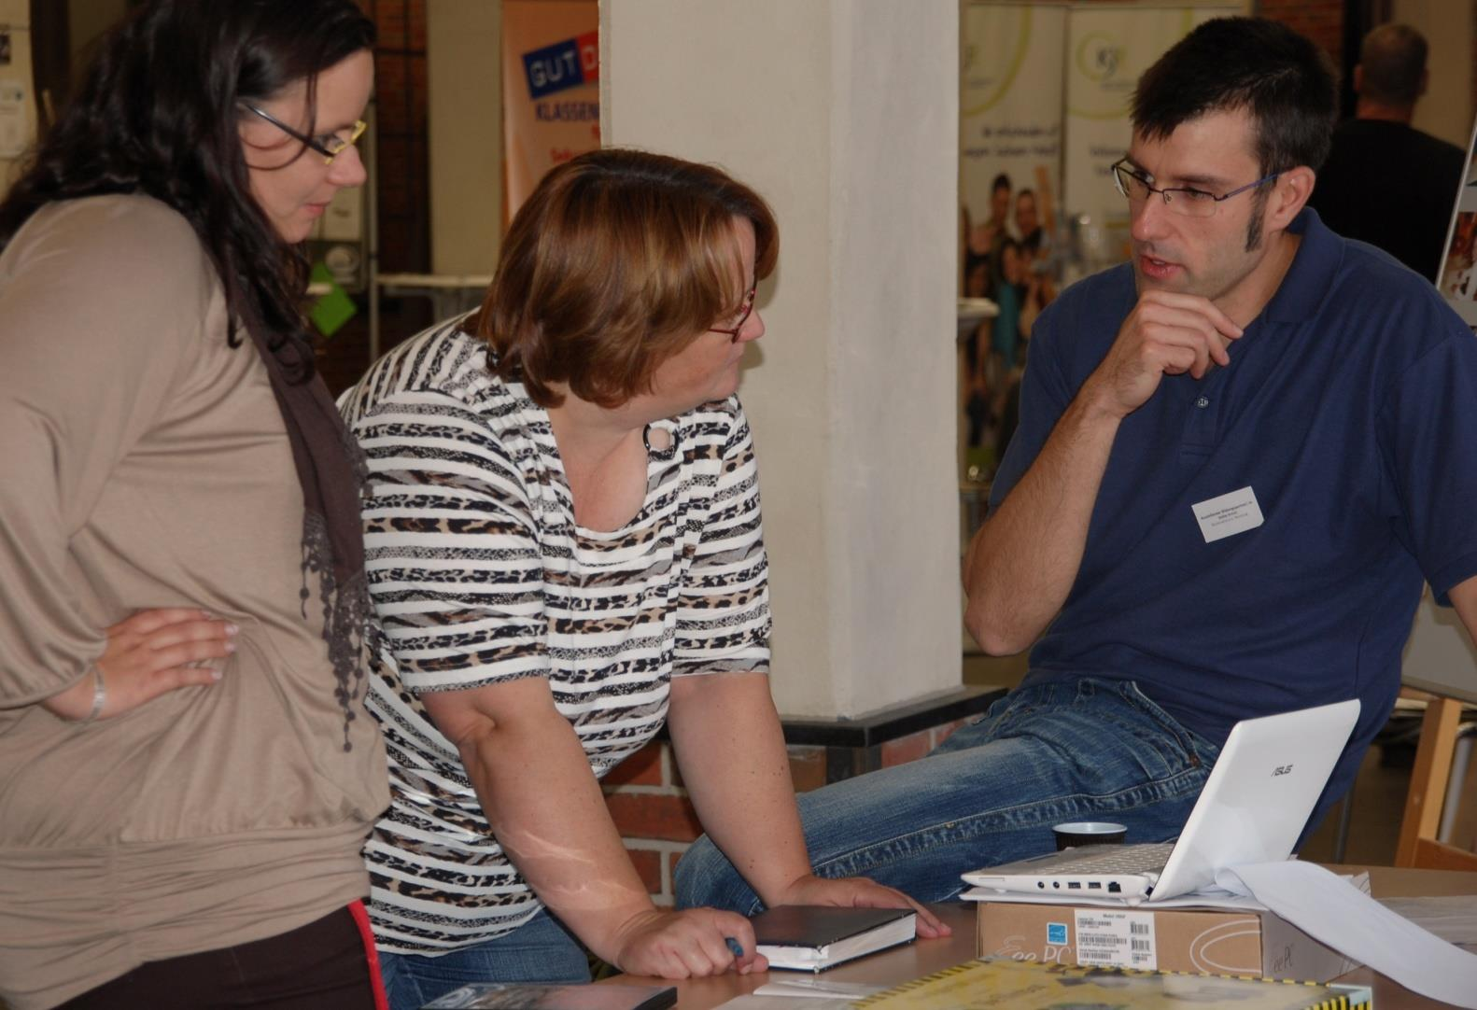
FUNDAMENTAL PREMISE
All the adult partners who go beyond their own discipline, to seek perspectives from other areas, and systematically integrate them in to their own actions, can work professionally and effectively.
Sylvia Ruge
Programm Manager &
Director of DKJS regional office SA

Slide 9
Strategies & practice
Educational practice
Federal state level
Case management
Regional level
Group work
(addiction, violence, bullying prevention)
Project work with parents
as partners for education
Educational planning for
target-oriented and effective learning
Project work with parents, experiential learning,
real participation,
student council etc.
Sylvia Ruge
Programm Manager &
Director of DKJS regional office SA

Slide 10
Strategies & practice
Regional level
Projects accompanying a
school form transition
(for example: from primary school to secondary school)
Federal state level
Coordination of uniform truancy measures
throughout all schools
Educational practice
Needs analysis and directions with
support for schoolchildren, parents and educators
Professional development, peer counseling
Committee work and development of common objectives and concepts for the design
of educational environments
Sylvia Ruge
Programm Manager &
Director of DKJS regional office SA

Slide 11
Strategies & practice
Federal state level
Regularly scheduled meetings
Program forum
Quality circle meetings
Public relations, educational material
Educational practice
Professional development, conferences
Sachsen-Anhalt LIGA der Wohlfahrt working group for school social work
Regional level
Sylvia Ruge
Programm Manager &
Director of DKJS regional office SA

Slide 12

Prospect
→ 2015 - 2020, funding of approx. € 130 million granted by the state of Saxony-Anhalt and European Social Funds.
→ Approximately 370 schools with school social work
(proportionately more primary schools)
What we want to learn together …
How can we intensify the participation of children, youths and their parents?
How can we strategically ensure individual and effective learning in the schools?
How do inclusive learning environments in schools and in a social area under municipal jurisdiction succeed?
Which quality standards can actors arrange in the federal state as mandatory, for successful cooperation between the school and youth services?
How can school social work and existing cooperation structures become established and receive financing?
Sylvia Ruge
Programm Manager &
Director of DKJS regional office SA

Slide 13
Recommendations
…two main aspects:
Multi-perspectivity, multi-professionalism and networks
&
School development,
science and politics
Sylvia Ruge
Programm Manager &
Director of DKJS regional office SA

Slide 14
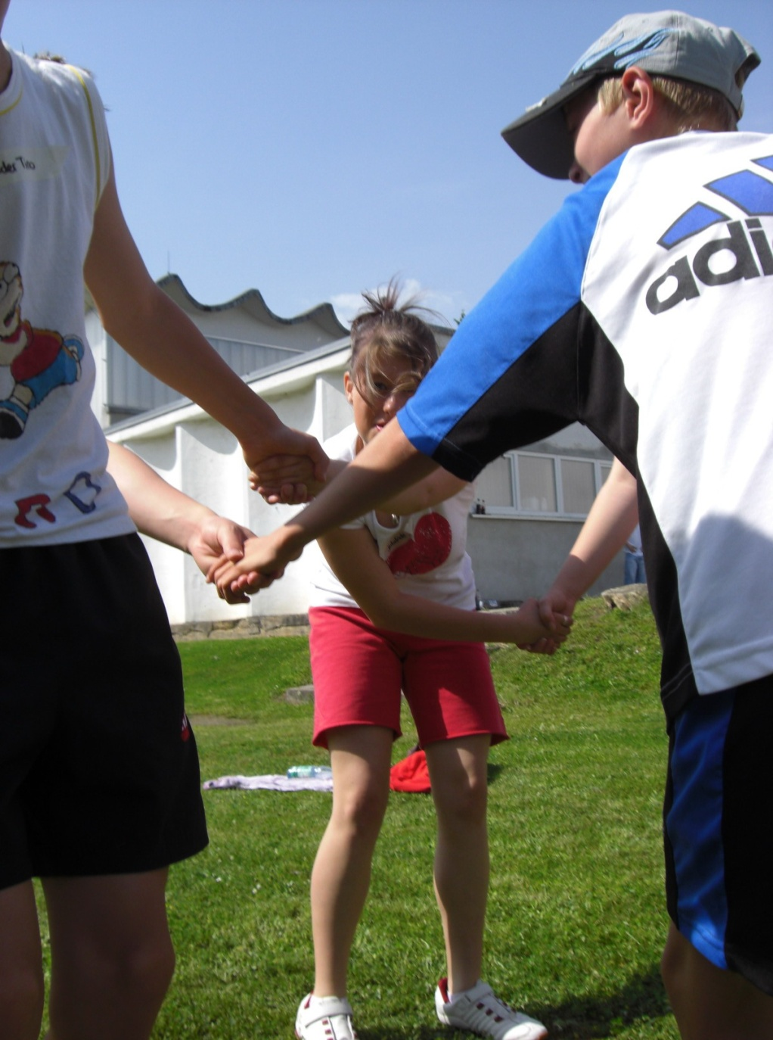
Thank you for
your kind attention!
We welcome your questions, comments or suggestions and would be pleased to get in further contact!
Deutsche Kinder- und Jugendstiftung
Regionalstelle Sachsen-Anhalt
Edithawinkel 2, 39108 Magdeburg
Germany
Tel: +49 391 5628770
Fax: +49 391 56287711
E-Mail: schulerfolg-sichern@dkjs.de
www.schulerfolg-sichern.de & www.dkjs.de
Sylvia Ruge
Programm Manager &
Director of DKJS regional office SA

