Slide 1
NEET-stories in the city
Patrick Manghelinckx
Managing director JES
www.jes.be
Notes:
Vzw: Association without lucrative purpose OR nonprofit organisation (NPO)

Slide 2
Structural youth unemployment in cities
In 2007 is 12% of the 18- to 25-year-olds in the Flemish region unemployed, in 2012 up to 12.8%
 | 2008 | 2013 | January 2014
Ghent | 18% | 23% | 26,26%
Antwerp | 19,2% | 29,1% | 28,27%
Brussels | 31,7% | 32% | 29%
Source: VDAB – Arvastat/ KBS
Note: Grades differ from source to source. Having knowledge of the possible interpretations or comparisons.

Slide 3
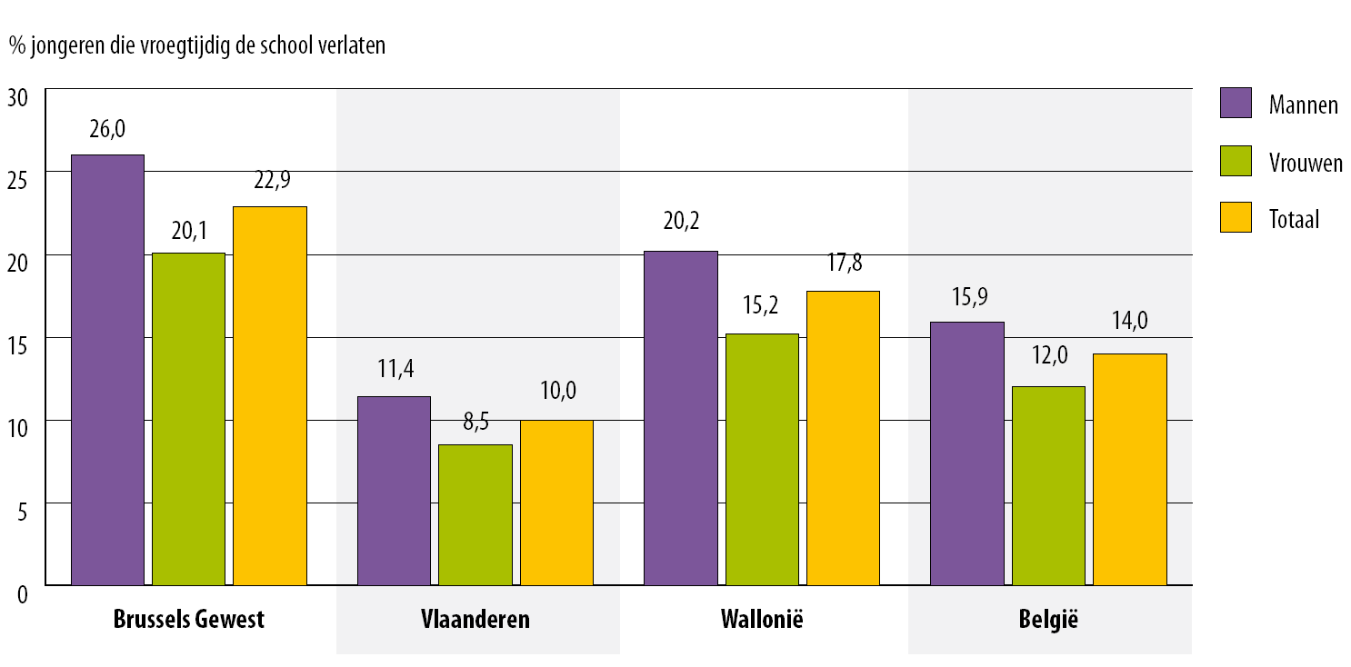
Drop-outs (2008 and 2012)

Slide 4
Profile
Not only one profile, but multiple ones
Insight in profile through registration
Multiple profiles demand divers approach & method

Slide 5
Methods and tools
C-Stick: digital portfolio and job application tool
I-POP: Training kit and publication
WIJ: work experience workshops Ghent and Antwerp
Werkkracht(=Workforce): tool and method to present yourself visually
FOCUS 18-25: intense weekends of competence development combined with experiental learning
Publication ‘Between street and counter’
www.jes.be

Slide 6
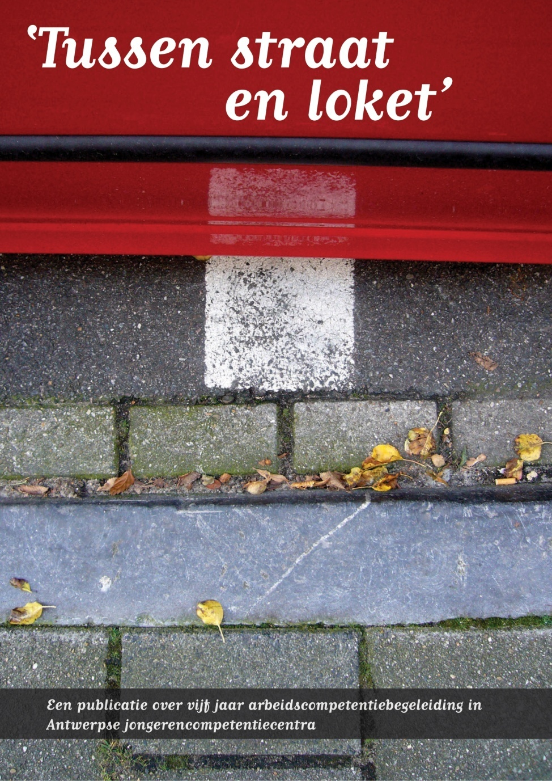

Slide 7
WAC in 2014
WAC= work-related acquired competences
253 youngsters in coaching
  School: 70 (28%)
  Training: 25 (21 new training)
  Job short term: 74
  Job long term: 5
    + 31

Slide 8
WAC in 2014
Hidden NEET at intake
  9/55 (16%)
  In 2013 55 at intake
Quantitative & qualitative analysis
NEET research (2015)

Slide 9
WAC in 2014
Features
  Age: 23
  Actions: administration, school, compose motivation letters and resume, job interview, training of attitudes.
  Boys Maroccan origin
  60% vocational secondary education

Slide 10
BRUSSELS
Street corner work
In May we start with an outreach approach
  European Youth Initiative
  10-15% NEET at moment of intake screening, orientation and training

Slide 11
Conclusions and recommendations
We help youngsters, no matter what
Outreach as a method
Coaching requires time
Safety net versus trampoline

Slide 12
Conclusions and recommendations
Measurement leads to knowledge: in need of more qualitative research about (and with) NEET-youngsters
Terms and conditions: evaluation of a Tender approach towards a durable society
Employment market vs employment welfare

Slide 13

Thank you
Patrick.Manghelinckx@jes.be
www.jes.be

